Slide 1

Data Dashboard
Notes:
Vinc

Slide 2
AGENDA
Team Introduction
Client Background
Project Scope
Data
Our Map
Challenges
Future Plans
Notes:
Vinc

Slide 3
MEET OUR TEAM
Vincent Chung: Project Manager and Software Developer
Selin Erdogan: Communications Lead and Database Developer
Jonathan Evans: Software Developer
Manuel Orallo: Data Engineer
Notes:
Vinc

Slide 4
CLIENT BACKGROUND
Langley Park Civic Association is a nonprofit organization that aims to improve the quality of life of the Langley Park community and its neighboring jurisdictions.
It started as a group of Latino parent leaders looking to create fun spaces for their children.
Points of contact: Norberto Martinez and Angela Gonzales
Notes:
Selin

Slide 5
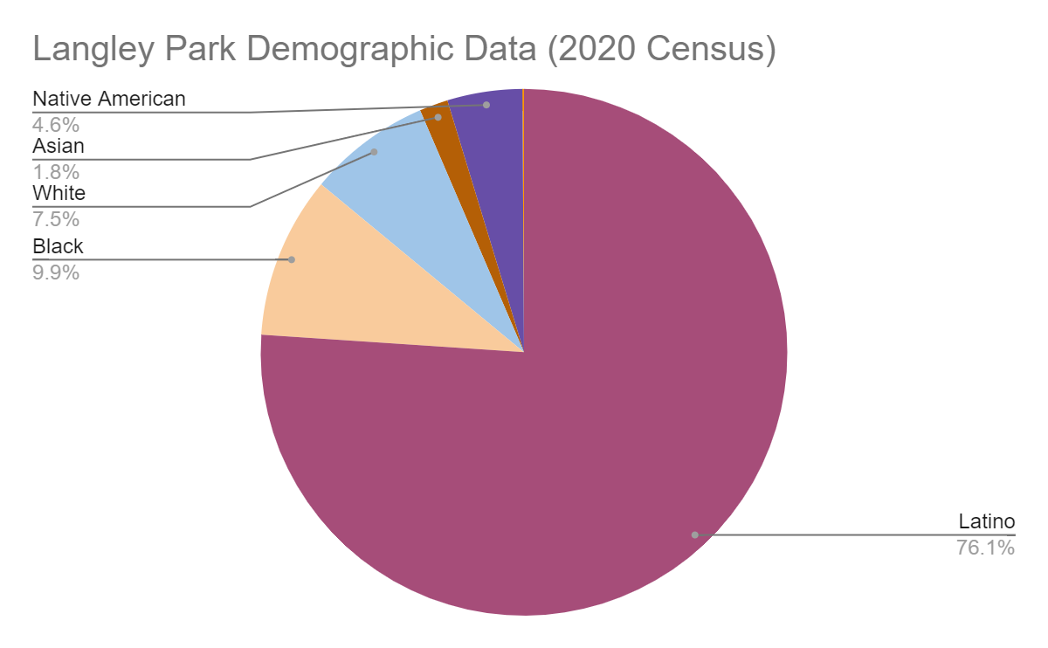
DEMOGRAPHIC DATA
Population: 21.8k
Median age: 29.3
Median household income: $77,731
45% of residents are US citizens
10k people in the workforce, with 37% of them in construction
Notes:
Selin

Slide 6
PROJECT SCOPE
In our first meeting, we discussed some current issues in the Langley Park area that we could look at.
These included:
Legal food vending areas
Lack of public trash cans
Purple line effect on the area and housing market
Improve green spaces
Notes:
Selin

Slide 7
PROJECT SCOPE CONT.
However, we found that there was not enough data to carry out those projects.
After discussion with the group and our client we decided to land on an interactive map consisting of key locations in the Langley Park community.
During our second meeting, we confirmed the scope and deliverables for this map.
Notes:
Selin

Slide 8
WHAT ARE WE DOING?
Residents of Langley Park need resources to help them navigate the community. Our map will aim to focus on these resources.
Education
Recreation
Social/legal services
Community services
Religious
Health
Youth services
Transit
We are actively collaborating with the Langley Park Website Assessment team to integrate the map into their website
Notes:
Selin

Slide 9
DATA
We were able to build off an existing database from the previous semester’s group that already included some community resources in the Langley Park area.
However, in order to optimize this data for our map we had to make some additions and do some cleaning.
We Added: Locations, Hours of operation, Latitude/longitude coordinates, Website links, Categories for filtering
Notes:
Man

Slide 10
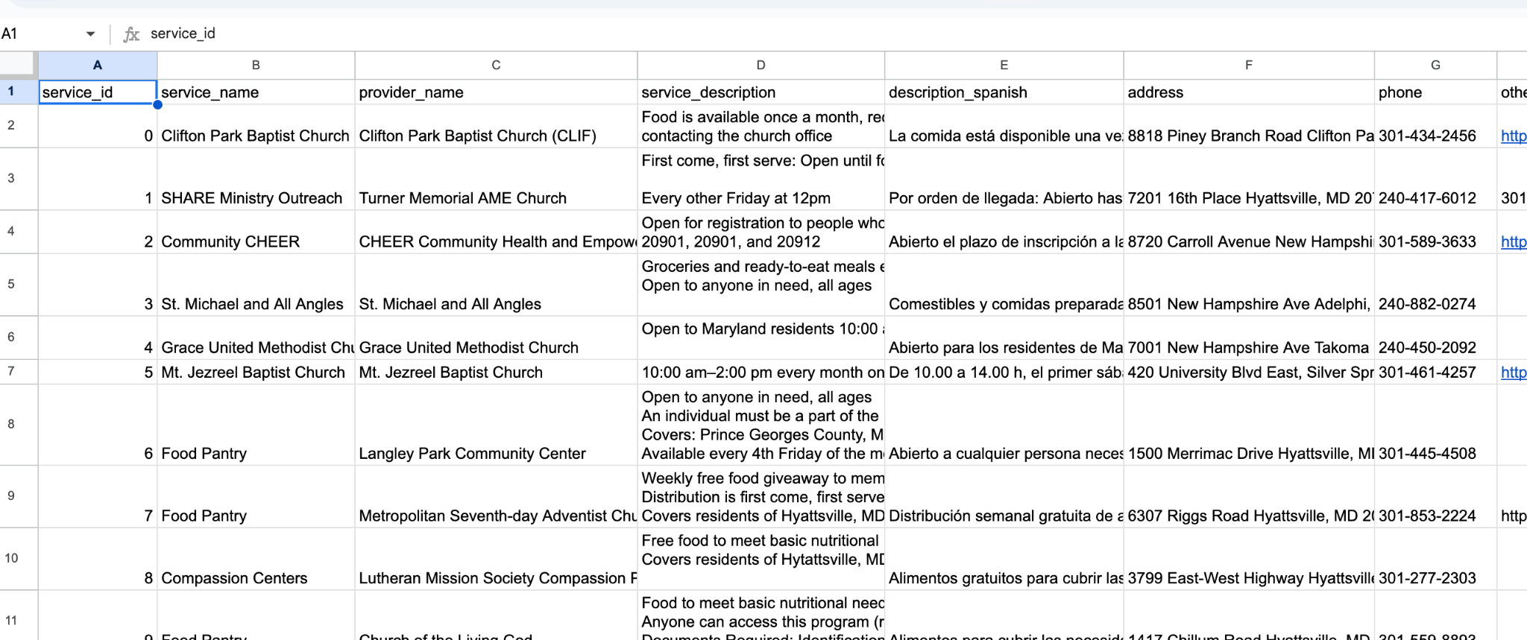
PREVIOUS DATABASE

Slide 11
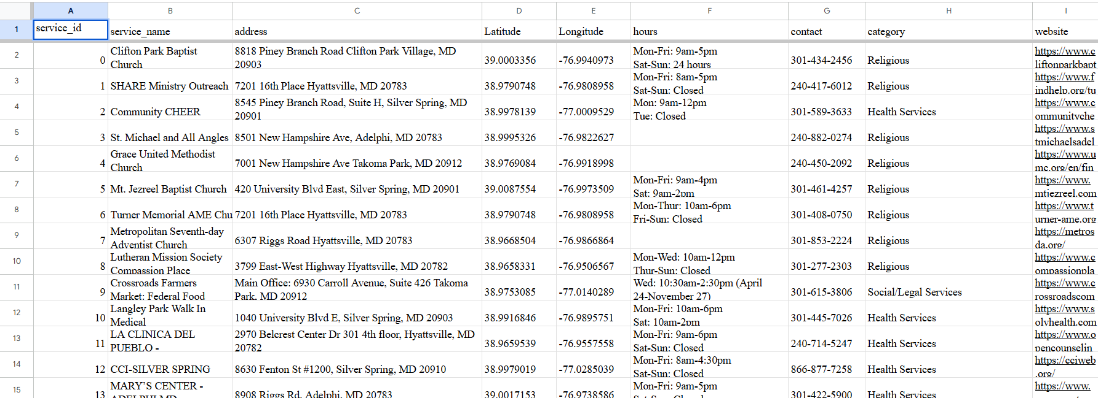
OUR UPDATED DATABASE
Notes:
Man

Slide 12
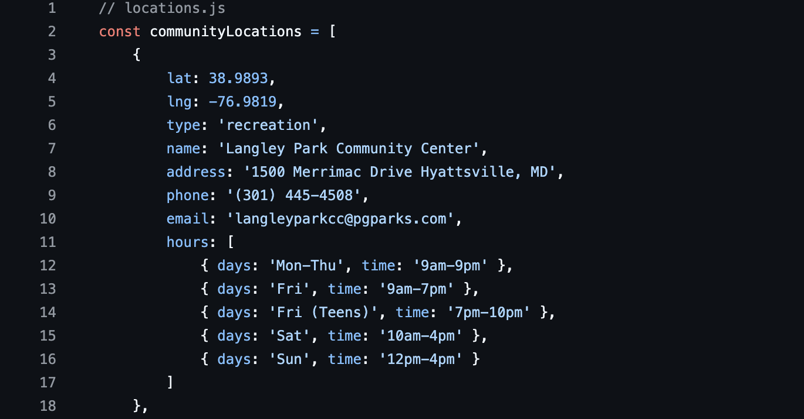
FINAL DATABASE
https://github.com/vincentchung2002/langley-park-civic-dashboard/blob/main/locations.js
Notes:
Man

Slide 13

MAPPING SOFTWARE
In order to allow easy integration into the Langley Park Civic Association website we decided to use Leaflet.js.
Leaflet is an open-source JavaScript library used to make interactive maps.
It works efficiently across all major desktop and mobile platforms, can be extended with lots of plugins, and has a easy to use and well-documented API.
Notes:
vincent

Slide 14
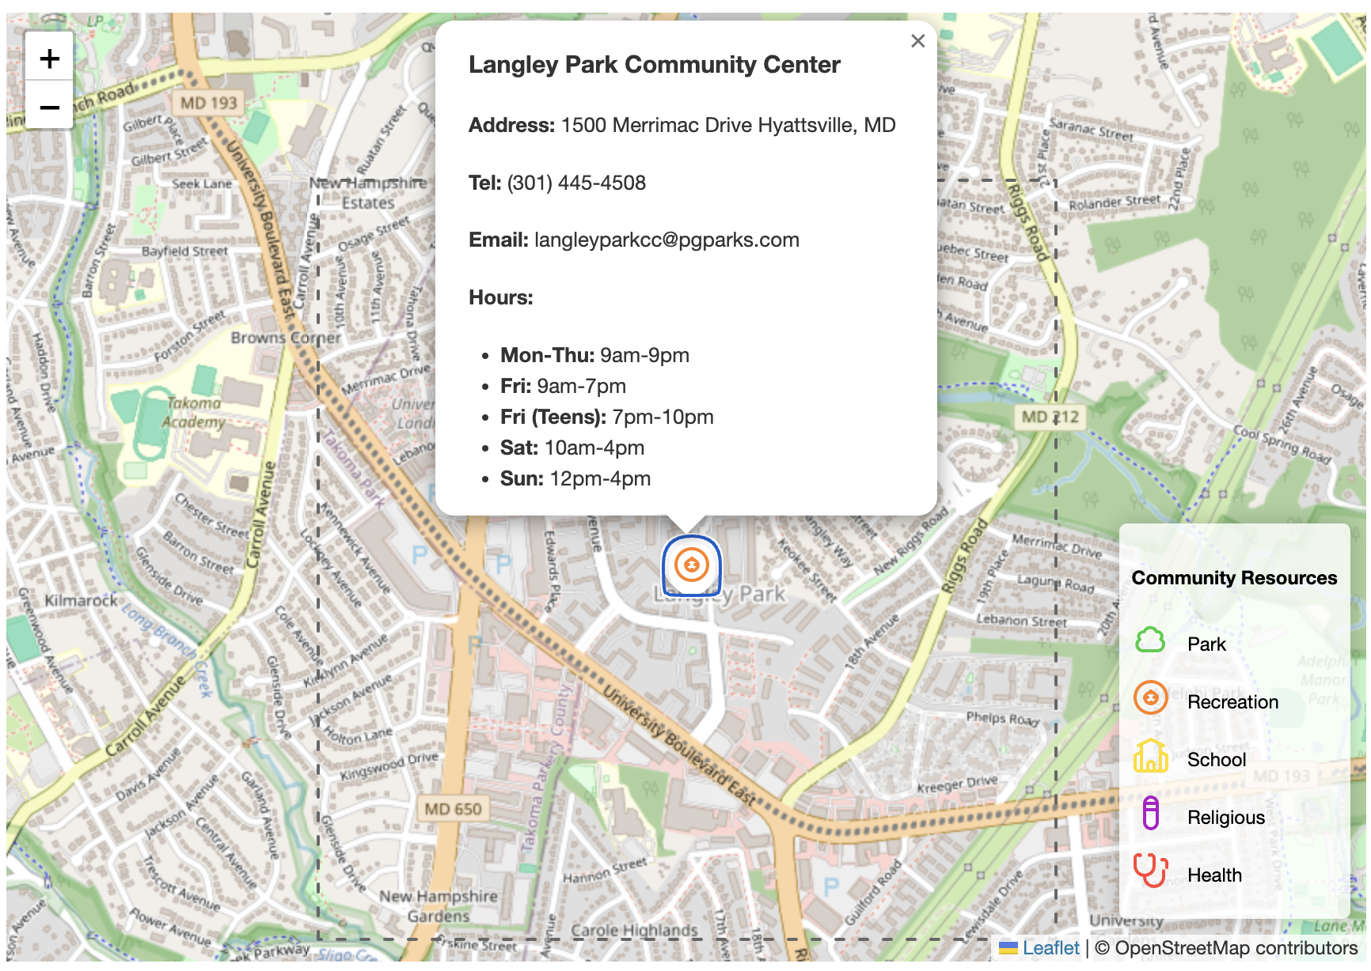
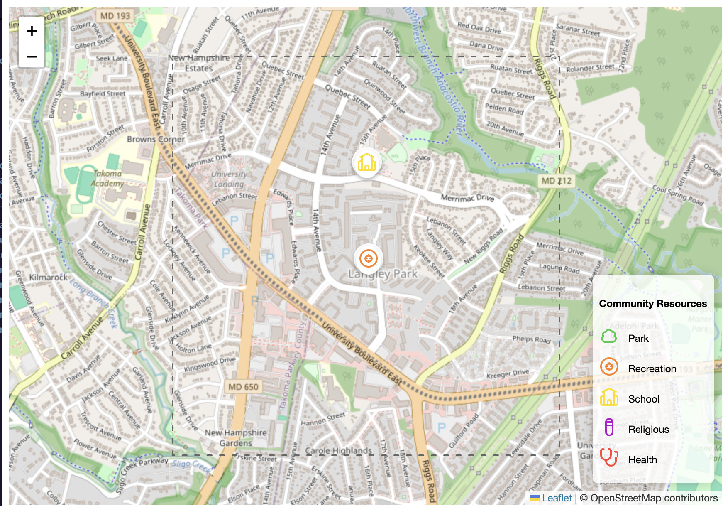
FIRST TEST
This iteration of the map consisted of some test points to see if the labeling worked properly. We also wanted to test the popup content that would appear when a location on the map was clicked.
Notes:
vinc

Slide 15
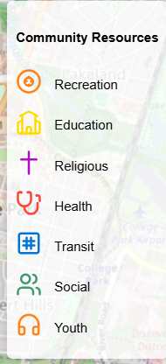
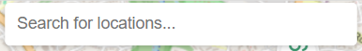
ADDING MORE FEATURES
The goal of the interactive map is to have an accessible and easy-to-use user interface. Users will be able to search specific locations or by filter by category.
Notes:
vinc

Slide 16
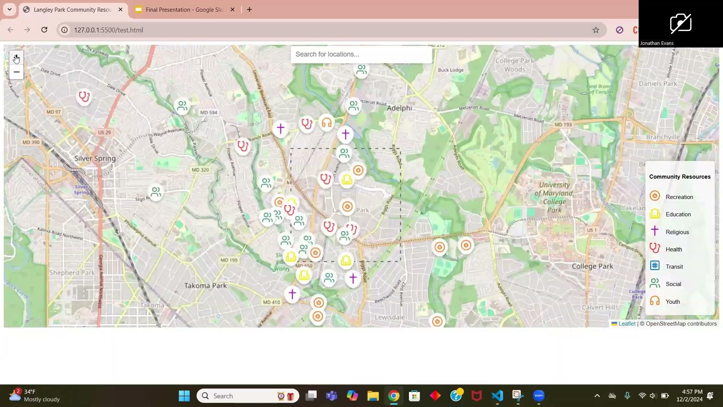
DEMONSTRATION OF MAP
https://vincentchung2002.github.io/langley-park-civic-dashboard/
https://github.com/vincentchung2002/langley-park-civic-dashboard
Notes:
vinc

Slide 17
User Guide
In order to allow our client to update the map without our help we developed a comprehensive and easy to understand guide that they can use.
https://github.com/vincentchung2002/langley-park-civic-dashboard/blob/main/User%20Guide.pdf
Notes:
vinc

Slide 18
CHALLENGES
CHALLENGES FACED
Deciding on a clear deliverable/topic
Finding a map software that was free and compatible with the WIX website
Tedious process of cleaning/transferring data
Excel → JSON
Last minute requests from the client regarding changes to the map

Slide 19
CHALLENGES CONT.
LONG TERM/FUTURE CHALLENGES
Map maintenance post project
Potentially creating a guide for next semester’s Langley Park team to keep the map running smoothly

Slide 20
FINAL DELIVERABLES
Github Repository
Map code
Database
User Guide
Slide presentation

Slide 21
FUTURE PLANS
We plan on updating the database with new locations until we present to our client in order to have it as ready as possible.
We have prepared a user manual/guide as a resource for our client once we are no longer working with them.
This guide will include tutorials on how to update the map with new locations and how they can add temporary event locations as well.

Slide 22
SUGGESTIONS FOR FUTURE
LANGLEY PARK GROUP
As we wrap up our contributions to this project we have come up with some points and suggestions that the future students of this project could build on.
Mapping of transit lines connecting different metro stations
Pictures added to the popup content in locations
Integration of a 3D map like Google Earth to capture more realism
Addition of green line transit points

Slide 23
THANK YOU!
ANY QUESTIONS?

